Slide 1
Mechanics
Moments
Twitter: @Owen134866
www.mathsfreeresourcelibrary.com

Slide 2
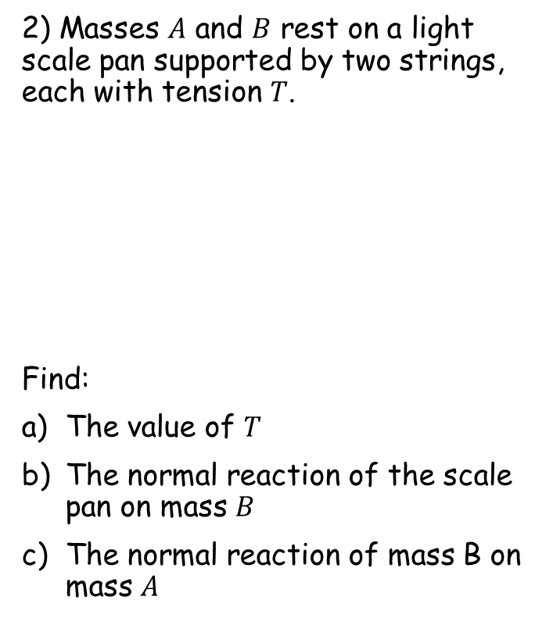















Prior knowledge check
Find the value of $x$ in each of the following:
a) b)
2) Masses $A$ and $B$ rest on a light scale pan supported by two strings, each with tension $T$.
Find:
The value of $T$
The normal reaction of the scale pan on mass $B$
The normal reaction of mass B on mass $A$
$${65}^{°}$$
$$13.1cm$$
$$T$$
$$T$$
$$x$$
$$13.2cm$$
$$x$$
$${40}^{°}$$
$$A$$
$$12cm$$
$$10cm$$
800g
$$B$$
1.4kg
$$10.8N$$
$$21.6N$$
$$7.8N$$

Slide 3
Teachings for
Exercise 4A

Slide 4
Moments
5N
4N
You can find the moment of a force acting on a body
Up until this point you have learnt about forces pushing or pulling a particle in a particular direction
The particle does not turn round, it just moves in a direction, based on the sum of the forces
For moments, we replace the particle with a straight rod (often called a lamina)
Imagine the rod had a fixed ‘pivot point’
A force acting on the rod at the centre, beneath the pivot point, will not cause it to move
If the force is moved to the side however, the rod will rotate around the pivot point
A greater force will cause the turning speed to be faster
If the force is further from the pivot point, the turning speed will be faster as well…
7gN
.
6N
6N
6N
.
6N
4A

Slide 5




Moments
3m
You can find the moment of a force acting on a body
The turning motion caused by a force is dependant on:
The magnitude of the force
A bigger force causes more turn
The distance the force is from the pivot point
A bigger distance causes more turn
(For example, the further you push a door from the hinge, the less effort is required to close it.)
To calculate the total moment about a point:
Moment about a point = Force x Perpendicular distance
C
5N
$$Moment about C$$
$$=5N ×3m$$
$$=15Nm$$
$$clockwise$$
Moments are measured in Newton-metres
→ You must always include the direction of the moment
(either clockwise or anticlockwise)
→ The distance must always be perpendicular from the pivot to the force itself…
4A

Slide 6




Moments
4N
You can find the moment of a force acting on a body
The turning motion caused by a force is dependant on:
The magnitude of the force
A bigger force causes more turn
The distance the force is from the pivot point
A bigger distance causes more turn
(For example, the further you push a door from the hinge, the less effort is required to close it.)
To calculate the total moment about a point:
Moment about a point = Force x Perpendicular distance
F
2m
Calculate the moment of the force about point F
$$Moment about F$$
$$=4N ×2m$$
$$=8Nm$$
$$anticlockwise$$
4A

Slide 7




Moments
You can find the moment of a force acting on a body
The turning motion caused by a force is dependant on:
The magnitude of the force
A bigger force causes more turn
The distance the force is from the pivot point
A bigger distance causes more turn
(For example, the further you push a door from the hinge, the less effort is required to close it.)
To calculate the total moment about a point:
Moment about a point = Force x Perpendicular distance
A
4m
4Sin30
30°
9N
Calculate the moment of the force about point A
→ Draw a triangle to find the perpendicular distance!
$$Moment about A$$
$$=9N ×4Sin30m$$
$$=18Nm$$
$$anticlockwise$$
4A

Slide 8
Teachings for
Exercise 4B

Slide 9








Moments
(1)
(3)
5N
3N
You can find the sum of the moment of a set of forces acting on a body
Sometimes you will have a number of moments acting around a single point.
You need to calculate each one individually and then choose a positive direction
Adding the forces together will then give the overall magnitude and direction of movement
2m
1m
1m
P
4N
(2)
Calculate the sum of the moments acting about the point P
→ Start by calculating each moment individually (it might be useful to label them!)
(1)
$$5N×3m$$
$$=15Nm$$
$$clockwise$$
(2)
$$4N×1m$$
$$=4Nm$$
$$anticlockwise$$
(3)
$$3N×1m$$
$$=3Nm$$
$$anticlockwise$$
If we had chosen anticlockwise as the positive direction our answer would have been -8Nm anticlockwise
→ This is just 8Nm clockwise (the same!)
Choosing clockwise as the positive direction…
$$15Nm−4Nm−3Nm$$
$$=8Nm$$
$$clockwise$$
4B

Slide 10








Moments
(1)
You can find the sum of the moment of a set of forces acting on a body
Sometimes you will have a number of moments acting around a single point.
You need to calculate each one individually and then choose a positive direction
Adding the forces together will then give the overall magnitude and direction of movement
5N
2m
4m
P
(2)
5N
Calculate the sum of the moments acting about the point P
→ Start by calculating each moment individually (it might be useful to label them!)
(1)
$$5N×2m$$
$$=10Nm$$
$$clockwise$$
(2)
$$5N×4m$$
$$=20Nm$$
$$anticlockwise$$
Choosing anticlockwise as the positive direction…
$$20Nm−10Nm$$
$$=10Nm$$
$$anticlockwise$$
4B

Slide 11












Moments
(1)
5N
4N
(3)
You can find the sum of the moment of a set of forces acting on a body
The diagram to the right shows 3 forces acting on a light rod.
Find the resultant moment about point P (ie – if the rod were fixed at point P, how would it rotate?)
4sin80
3sin40
80˚
40˚
1m
3m
P
3m
6N
(2)
→ Start by calculating each moment individually
(1)
$$5N×4sin80m$$
$$=20sin80 Nm$$
$$clockwise$$
(2)
$$6N×3m$$
$$=18 Nm$$
$$anticlockwise$$
(3)
$$4N×3sin40m$$
$$=12sin40 Nm$$
$$anticlockwise$$
Choosing clockwise as the positive direction…
$$=20sin80−18−12sin40$$
$$=−6.01Nm clockwise$$
$$=6.01Nm anticlockwise$$
4B

Slide 12
Teachings for
Exercise 4C

Slide 13


Moments
You can solve problems about bodies resting in equilibrium by equating the clockwise and anticlockwise moments
When a rigid body is in equilibrium, the resultant force in any direction is 0
The moments about any point on the object will also sum to 0
4m
4m
Y
10N
10N
(1)
(2)
Calculate the sum of the moments acting about the point Y
→ Calculate each moment separately
(1)
$$10N×4m$$
$$=40Nm$$
$$clockwise$$
(2)
$$10N×4m$$
$$=40Nm$$
$$anticlockwise$$
As the moments are equal in both directions, the rod will not turn and hence, is in equilibrium!
As the rod is fixed at Y is will not be lifted up by the forces either!
4C

Slide 14



Moments
You can solve problems about bodies resting in equilibrium by equating the clockwise and anticlockwise moments
When a rigid body is in equilibrium, the resultant force in any direction is 0
The moments about any point on the object will also sum to 0
2m
6m
Z
1N
3N
(2)
(1)
Calculate the sum of the moments acting about the point Z
→ Calculate each moment separately
(1)
$$3N×2m$$
$$=6Nm$$
$$clockwise$$
(2)
$$1N×6m$$
$$=6Nm$$
$$anticlockwise$$
As the moments are equal in both directions, the rod will not turn and hence, is in equilibrium!
4C

Slide 15










Moments
R_{A}
R_{C}
(1)
You can solve problems about bodies resting in equilibrium by equating the clockwise and anticlockwise moments
When a rigid body is in equilibrium, the resultant force in any direction is 0
The moments about any point on the object will also sum to 0
The diagram to the right shows a uniform rod of length 3m and weight 20N resting horizontally on supports at A and C, where AC = 2m.
Calculate the magnitude of the normal reaction at both of the supports
2m
1m
A
B
1.5m
0.5m
C
(2)
“Uniform rod” = weight is in the centre
20N
As the rod is in equilibrium, the total normal reaction (spread across both supports) is equal to 20N (the total downward force)
$$R_{A}+R_{C}=20$$
Take moments about C (you do not need to include R_{C} as its distance is 0)
(1)
$$2×R_{A}$$
$$=2R_{A}$$
$$clockwise$$
(2)
$$0.5×20$$
$$=10Nm$$
$$anticlockwise$$
The clockwise and anticlockwise moments must be equal for equilibrium
This makes sense – as RC is closer to the centre of mass it is bearing more of the object’s weight!
$$2R_{A}=10$$
Divide by 2
$$R_{A}=5N$$
Use the original equation to calculate R_{C}
$$R_{C}=15N$$
4C

Slide 16



Moments
R_{C}
40g
2R_{C}
80g
R_{D}
You can solve problems about bodies resting in equilibrium by equating the clockwise and anticlockwise moments
A uniform beam, AB, of mass 40kg and length 5m, rests horizontally on supports at C and D where AC = DB = 1m.
When a man of mass 80kg stands on the beam at E, the magnitude of the reaction at D is double the reaction at C.
By modelling the beam as a rod and the man as a particle, find the distance AE.
1m
1.5m
1.5m
1m
A
B
C
E
D
“Uniform beam” = weight is in the centre
As the reaction at D is bigger, the man must be closer to D than C
40g
80g
The normal reactions must equal the total downward force
$$3R_{C}=120g$$
$$R_{C}=40g$$
Divide by 3
$$R_{D}=80g$$
R_{D} is double this
4C

Slide 17
















Moments
(1)
40g
(4)
80g
You can solve problems about bodies resting in equilibrium by equating the clockwise and anticlockwise moments
A uniform beam, AB, of mass 40kg and length 5m, rests horizontally on supports at C and D where AC = DB = 1m.
When a man of mass 80kg stands on the beam at E, the magnitude of the reaction at D is double the reaction at C.
By modelling the beam as a rod and the man as a particle, find the distance AE.
1m
1.5m
1.5m
1m
A
x
B
C
E
D
(2)
40g
80g
(3)
Let us call the required distance x (from A to E)
Take moments about A
(we could do this around any point, but this will make the algebra easier)
(1)
$$1×40g$$
$$=40g Nm$$
$$anticlockwise$$
(2)
$$2.5×40g$$
$$=100g Nm$$
$$clockwise$$
(3)
$$x×80g$$
$$=80xg Nm$$
$$clockwise$$
So the man is standing 3.25m from A!
(4)
$$4×80g$$
$$=320g Nm$$
$$anticlockwise$$
Equilibrium so anticlockwise = clockwise
$$40g+320g$$
$$=100g+80xg$$
Group terms
$$360g$$
$$=100g+80xg$$
Cancel g’s
$$360$$
$$=100+80x$$
Calculate
$$3.25=x$$
4C

Slide 18



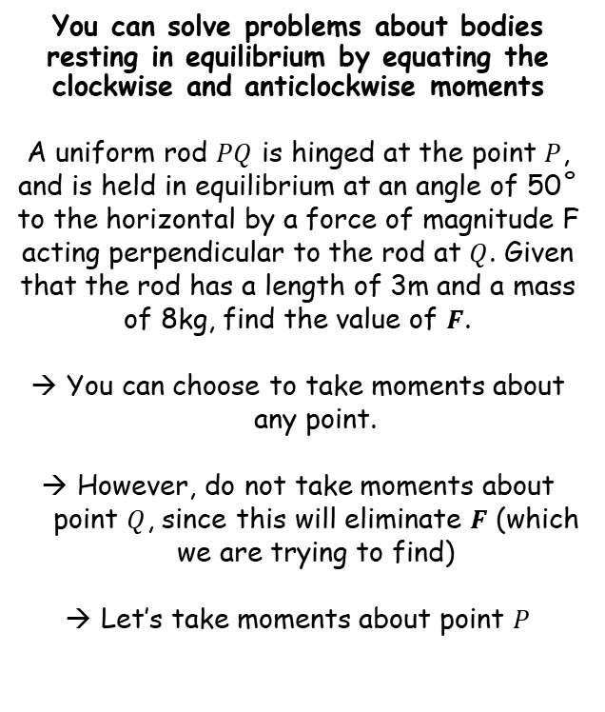













Moments
(2)
$$F$$
$$Q$$
You can solve problems about bodies resting in equilibrium by equating the clockwise and anticlockwise moments
A uniform rod $PQ$ is hinged at the point $P$, and is held in equilibrium at an angle of 50˚ to the horizontal by a force of magnitude F acting perpendicular to the rod at $Q$. Given that the rod has a length of 3m and a mass of 8kg, find the value of $F$.
You can choose to take moments about any point.
However, do not take moments about point $Q$, since this will eliminate $F$ (which we are trying to find)
Let’s take moments about point $P$
$$1.5m$$
$$3m$$
$$1.5m$$
(1)
$$8g N$$
$$P$$
50˚
$$1.5cos50$$
(1)
$$8g×1.5cos50$$
$$=12gcos50 Nm$$
$$clockwise$$
(2)
$$F×3$$
$$=3F Nm$$
$$anticlockwise$$
Since the system is in equilibrium, the clockwise and anticlockwise moments must be equal
$$3F=12gcos50$$
Divide by 3
$$F=4gcos50$$
Calculate
$$F=25.2 N$$
4C

Slide 19
Teachings for
Exercise 4D

Slide 20
















Moments
R_{M}
You can solve problems about non-uniform bodies by finding or using the centre of mass
The mass of a non-uniform body can be modelled as acting at its centre of mass
This means the weight of the rod may not necessarily be in the centre as it has been so far
Sam and Tamsin are sitting on a non-uniform plank AB of mass 25kg and length 4m.
The plank is pivoted at M, the midpoint of AB, and the centre of mass is at C where AC = 1.8m.
Tamsin has mass 25kg and sits at A. Sam has mass 35kg. How far should Sam sit from A to balance the plank?
A
1.8m
0.2m
x
B
C
M
(1)
25g
(2)
25g
35g
(3)
Let Sam sit ‘x’ m from the midpoint
Take moments about M (this way we don’t need to know R_{M})
(1)
$$2×25g$$
$$=50g$$
$$anticlockwise$$
(2)
0.$2×25g$
$$=5g$$
$$anticlockwise$$
(3)
$$x×35g$$
$$=35gx$$
$$clockwise$$
The rod is in equilibrium so anticlockwise = clockwise
$$50g+5g=$$
$$35gx$$
Group terms
$$55g=$$
$$35gx$$
Divide by g
$$55=$$
$$35x$$
Divide by 35
$$1.57=$$
$$x$$
Sam should sit 3.57m from A (or 0.43m from B)
→ Make sure you always read where the distance should be measured from!
4D

Slide 21



Moments
R_{C} = 3R_{D}
3R_{D}
15N
R_{C}
R_{D}
5N
You can solve problems about non-uniform bodies by finding or using the centre of mass
A rod AB is 3m long and has weight 20N. It is in a horizontal position resting on supports at points C and D, where AC = 1m and AD = 2.5m.
The magnitude of the reaction at C is three times the magnitude of the reaction at D.
Find the distance of the centre of mass of the rod from A.
A
1m
1.5m
0.5m
B
C
D
20N
Estimate where the centre of mass is on your diagram
We can replace RC with 3R_{D}
Now find the normal reactions
$$4R_{D}=20$$
Divide by 4
$$R_{D}=5$$
Calculate
$$R_{C}=15$$
4D

Slide 22













Moments
(1)
(3)
15N
5N
You can solve problems about non-uniform bodies by finding or using the centre of mass
A rod AB is 3m long and has weight 20N. It is in a horizontal position resting on supports at points C and D, where AC = 1m and AD = 2.5m.
The magnitude of the reaction at C is three times the magnitude of the reaction at D.
Find the distance of the centre of mass of the rod from A.
A
1m
1.5m
0.5m
B
x
C
D
20N
(2)
Now take moments about A, calling the required distance ‘x’
(You’ll find it is usually easiest to do this from the end of the rod!)
(1)
$$1×15$$
$$=15 Nm$$
$$anticlockwise$$
(2)
$$x×20$$
$$=20x Nm$$
$$clockwise$$
(3)
$$2.5×5$$
$$=12.5 Nm$$
$$anticlockwise$$
Equilibrium so anticlockwise = clockwise
$$15+12.5=$$
$$20x$$
Group terms
$$27.5=$$
$$20x$$
Calculate
$$1.38=$$
$$x$$
The centre of mass is 1.38m from A
4D

Slide 23
Teachings for
Exercise 4E

Slide 24













Moments
(1)
0
R_{D}
R_{C}
You can solve problems about bodies resting in equilibrium by equating the clockwise and anticlockwise moments
A uniform rod of length 4m and mass 12kg is resting in a horizontal position on supports at C and D, with AC = DB = 0.5m
When a particle of mass mkg is placed on the rod at point B, the rod is on the point of turning about D.
Find the value of m.
If the rod is on the point of turning around D, then there will be no reaction at C
R_{C} = 0
(the rod is barely in contact with support C, about to move upwards as it rotates round D)
0.5m
1.5m
1.5m
0.5m
A
B
C
D
(2)
12g
mg
(3)
Taking moments about D
(1)
$$This will be 0 as R_{C}=0$$
(2)
$$1.5×12g$$
$$=18g$$
$$anticlockwise$$
(3)
$$0.5×mg$$
$$=0.5mg$$
$$clockwise$$
Although it is on the point of turning, the rod is still in equilibrium
→ Anticlockwise = clockwise
The mass is 36kg
More than this and the rod will turn about D
Less than this and some of the normal reaction will be at C
$$18g =$$
$$0.5mg$$
Divide by g
$$18 =$$
$$0.5m$$
Multiply by 2
$$36 =$$
$$m$$
4E

Slide 25



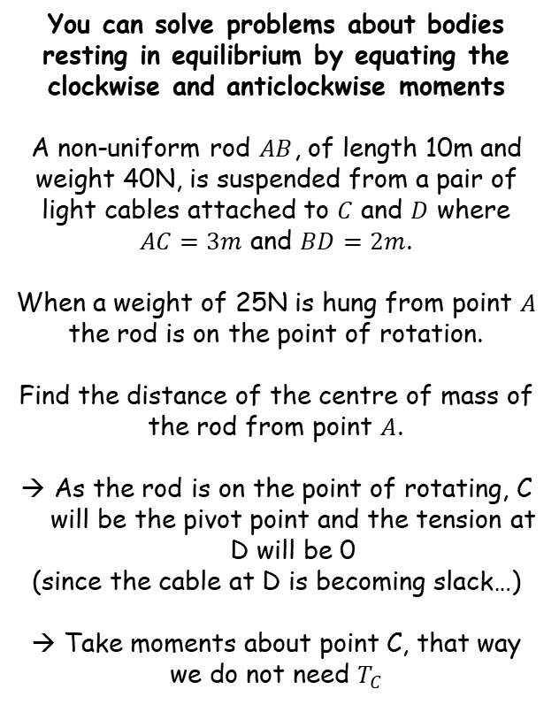












Moments
$$T_{C}$$
$$T_{D}$$
(3)
$$0$$
You can solve problems about bodies resting in equilibrium by equating the clockwise and anticlockwise moments
A non-uniform rod $AB$, of length 10m and weight 40N, is suspended from a pair of light cables attached to $C$ and $D$ where $AC=3m$ and $BD=2m$.
When a weight of 25N is hung from point $A$ the rod is on the point of rotation.
Find the distance of the centre of mass of the rod from point $A$.
As the rod is on the point of rotating, C will be the pivot point and the tension at D will be 0
(since the cable at D is becoming slack…)
→ Take moments about point C, that way we do not need $T_{C}$
A
3m
$$x$$
5m
2m
B
C
D
(1)
25N
(2)
Estimate the location of the centre of mass
40N
Take moments about C
(1)
$$25×3$$
$$=75 Nm$$
$$anticlockwise$$
(2)
$$40×x$$
$$=40x Nm$$
$$clockwise$$
(3)
$$This will be 0 as T_{D}=0$$
Now set the clockwise and anticlockwise components equal to each other
$$75=40x$$
Find the value of $x$
$$x=1.875$$
Remember we need the distance from A, so add on 3m
$$Distance=4.875$$
4E

